Slide 1
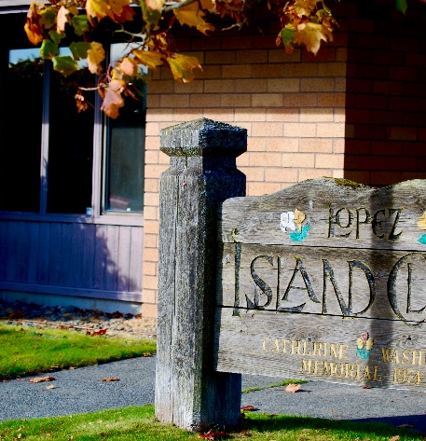

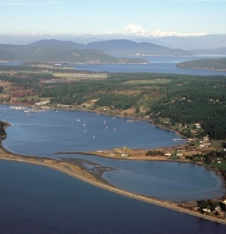

Clinic Planning: Next Steps
February 18th, 2026

Slide 2
A Required Care Model was developed with input from both groups and the community:
Clinical Model
  Minimum of 2 providers, at least one being an MD or DO comprising a minimum of 1.5 FTEE
  EHR (electronic health record, "My Chart”) with direct access to PT, Pharmacy, and EMS, preferably EPIC
  Open a minimum of 8AM to 5PM, M-F
  Same day care
  Telehealth availability
  24/7 EMS access to clinic
  Likely courtesy blood and x-ray testing
Desirable
  Woman provider
  Additional provider FTEE
  Access to specialty care

Slide 3
Required Care Model (cont.)
Oversight, management, communication, and infrastructure
  Transparent reporting of quality outcomes
  Direct managerial oversight (Clinic Manager)
  Direct clinical oversight (Medical Director)
  Frequent management reviews with LIHD (at least monthly), EMS, and CWMA
  Transparent fiscal reporting to LIHD
  Open communication between provider and LIHD/CWMA
  Infrastructure support, e.g., prior authorizations, referral coordination, billing, HR, credentialing and privileging, IT support.
  Active community communication and involvement

Slide 4
Six potential operators identified:
A pool of 8 potential partners were identified, six were selected as potential partners.
Discussions with potential partners
  Could they meet the clinical needs on Lopez?
  Would they be willing to partner with Lopez LIHD and CWMA?
  What is their commitment to quality comprehensive primary care?
From this group of six, a single potential partner rose above the rest.
  High quality health care at a reasonable cost
  Reimbursement increases
  Strong commitment to the communities they serve
  A proven high level of success and sustainability within multiple rural clinical sites

Slide 5


Who is the preferred partner?
The negotiating team is very pleased to recommend Sea Mar as our partner in the provision of primary care on Lopez Island.
For the past 6 weeks, LIHD and CWMA have been meeting , conducting due diligence, and communicating regularly.

Slide 6
What will Sea Mar provide?
Comprehensive primary care, health education, and care coordination.
Clinic operation at a minimum of 8AM to 5PM, M-F.
Minimum of 1.5 providers, at least one being a physician.
Access to same day care.
Monthly reviews including quality and fiscal reports.
Telehealth access.
EMS access to clinic 24/7.
Likely courtesy blood and x-ray tests. (Sea Mar believes they can do this. Just a few more items need to be done to confirm.)
EPIC electronic medical record.
Hospitalizations and specialty referrals where patient/insurance prefers.
Some specialty care available in their Mt. Vernon clinics and by telehealth.

Slide 7

1978 first comprehensive health center in South Seattle.
1985 opened a clinic in Mt. Vernon.
1989 opened a clinic in Marysville.
2026 provides services to 36 medical clinics, 30 dental clinics, 47 outpatient behavioral health clinics, four inpatient treatment centers,16 affordable housing properties and other social services.
Mission: providing quality, comprehensive health, human, housing, educational and cultural services to diverse communities, specializing in service to Latinos.
Sea Mar focuses on Serving UNDER RESOURCED Communities IN need of better access to primary care.

Slide 8
Why was Sea Mar chosen?
Hands down, the best choice for Lopez.
Sea Mar has a mission to provide services to underserved populations, “This is what we do”.
Review of their quality outcomes shows they provide excellent care at a reasonable cost.
Sea Mar never turns a patient away, regardless of ability to pay.
Site visits have disclosed satisfied employees, a consistent workforce, and a true dedication to their mission.
Federally Qualified Health Clinic (FQHC) status provides additional services and payment from Medicare and Medicaid, which has been used in the past to fund needed projects and may provide consideration for expansion of services on Lopez.
Sea Mar offered to hire current staff at their current salaries.
Sea Mar has a social conscience which is manifest in what they do.
Will bring EPIC.
Can be operational within the timeframe needed.

Slide 9
What is a Federally Qualified Health Clinic?
•Community based clinic
•Non-profit
•Provide high-quality primary and preventive care either directly or by referral
•Services often include primary care, dental care, mental health counseling, substance abuse treatment, and pharmacy services.
•Must have a sliding fee schedule based on patient income and family size. Care is provided regardless of income, insurance status, or ability to pay.
•FQHCs are governed by a patient-majority board of directors.
•FQHCs receive federal grants (HRSA), enhanced Medicare/Medicaid reimbursements, and access to the 340B drug pricing program.

Slide 10
Next Steps, Assuming Board Approval:
Negotiations for subsidy (LIHD) and clinic space (CWMA) continue.
Attorneys will begin drafting Definitive Agreement “Operating Agreement.”
LIHD and CWMA Boards will present information and answer questions at a Town Hall on February 23, 2026, 5:30-7:00 pm.
The contracts will then be finalized and presented to each Board, ideally in early March 2026.
If approved by both boards, the implementation planning (Sea Mar, UW, LIHD, CWMA) will commence immediately.
Sea Mar preferred date for occupying clinic is weekend of June 26-June 28, with plan to reopen on June 29, in advance of 4th of July. The goal is no lapse in service for residents.

Slide 11
Summary
Sea Mar is an excellent fit for Lopez Island.
Leadership is exceedingly flexible with a “one size does not fit all” mentality.
Depending upon demonstrated need and available funding, there is potential for expansion of services.
FQHC funding means there may be additional tax dollars either to return to the taxpayers or expand services.
Sea Mar is in discussions to potentially partner with PT, dentist, and pharmacy.
The negotiating team is very pleased to recommend Sea Mar as our future partner in healthcare.

